Slide 1
New Method Setup
Tungsten Rod
Glass
Capillary
Heater
Gold Nanowire
Vacuum

Slide 2
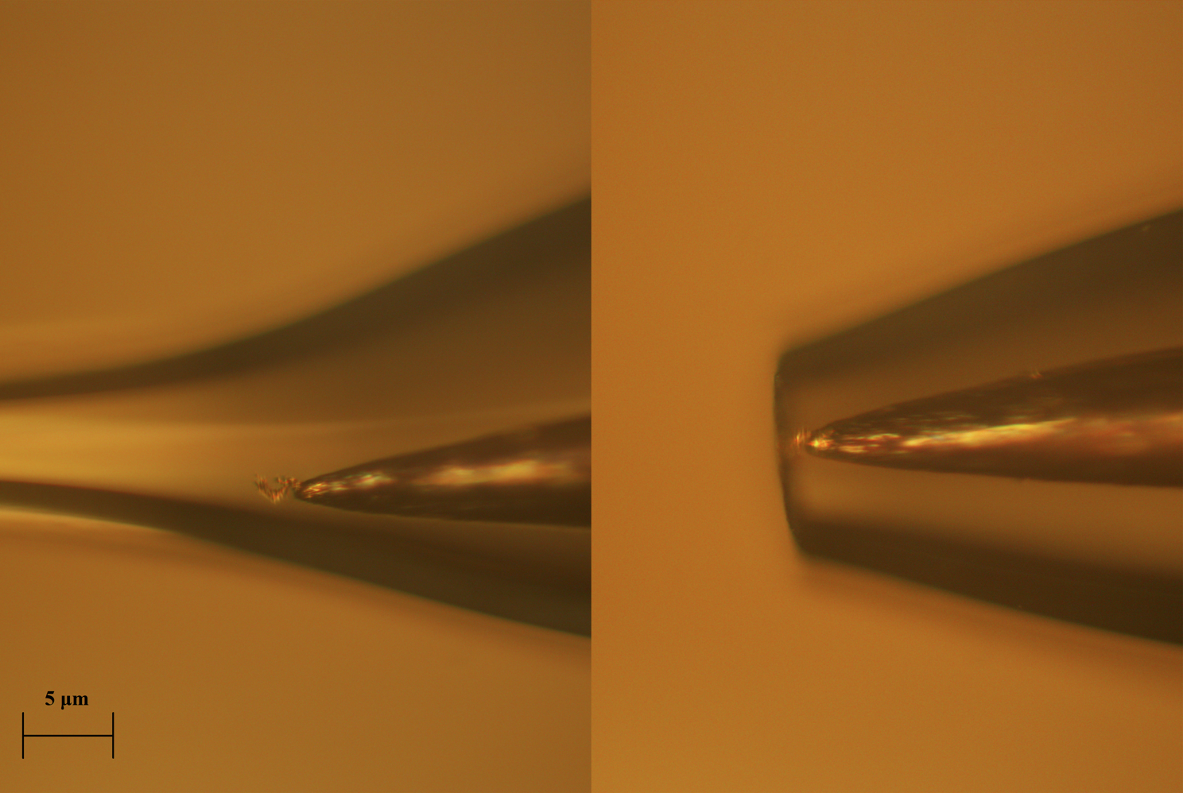

Slide 3
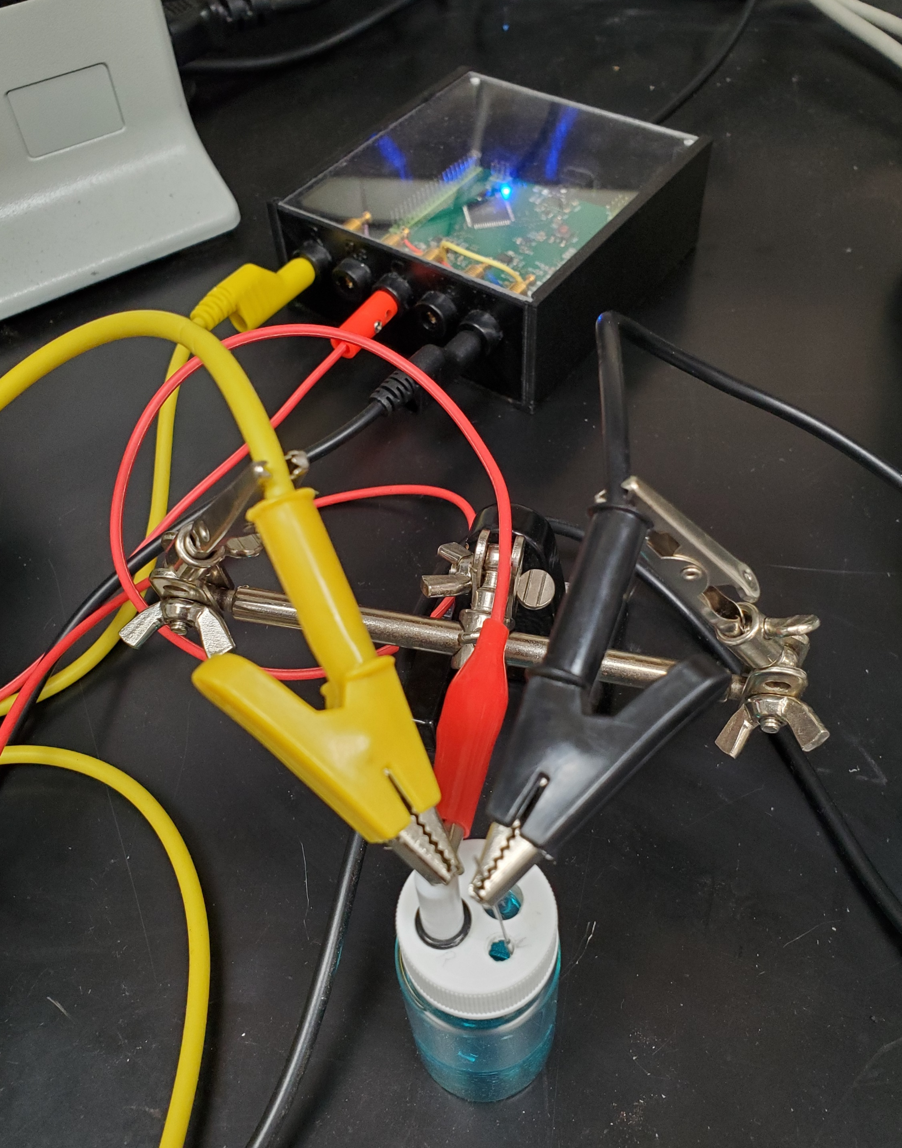
Cyclic Voltammetry Measurement
Dstat Potential State
3 electrodes system was widely used in cyclic voltammetry measurement.
By measuring voltage and current, a stable curve can be get and used to analyze the reaction information.
Solution: 0.1moml/L H2SO4 + 0.5 mol/L CuSO4.
Working electrode: Gold nanowire.
Reference electrode: Ag/AgCl reference electrode.
Counter electrode: Platinum Rod
CuSo4+H2SO4
Solution
Working
Counter
Reference

Slide 4
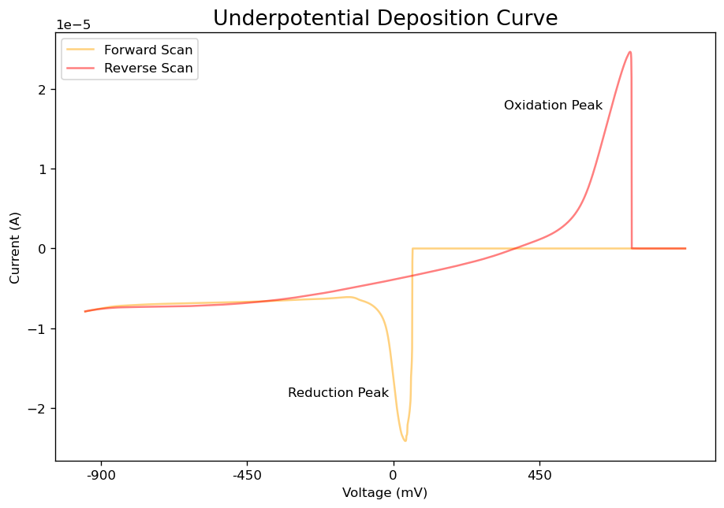
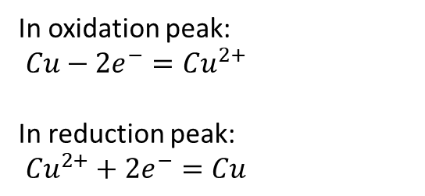
In oxidation peak:
$Cu−2e^{−}={Cu}^{2+}$
In reduction peak:
${Cu}^{2+}+2e^{−}=Cu$

